Slide 1
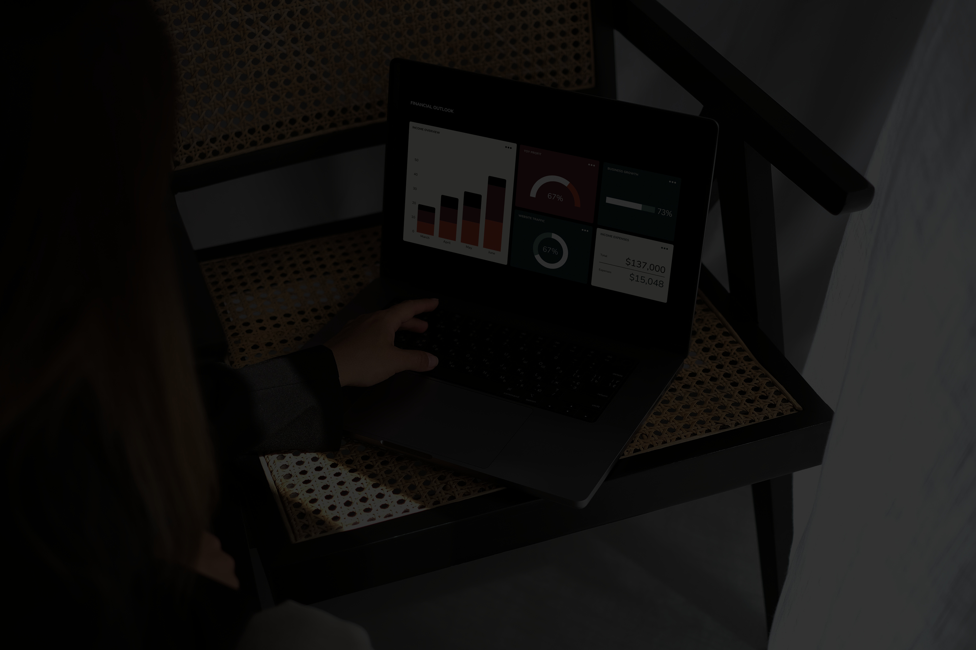
PRESENTATION
TELECOM CUSTOMER CHURN ANALYSIS
PREDICT CHURN AND DERIVE ACTIONABLE STRATEGIES TO RETAIN USERS IN A HIGHLY COMPETITIVE TELECOM ENVIRONMENT.
BY: GAYATRI SUKHE

Slide 2
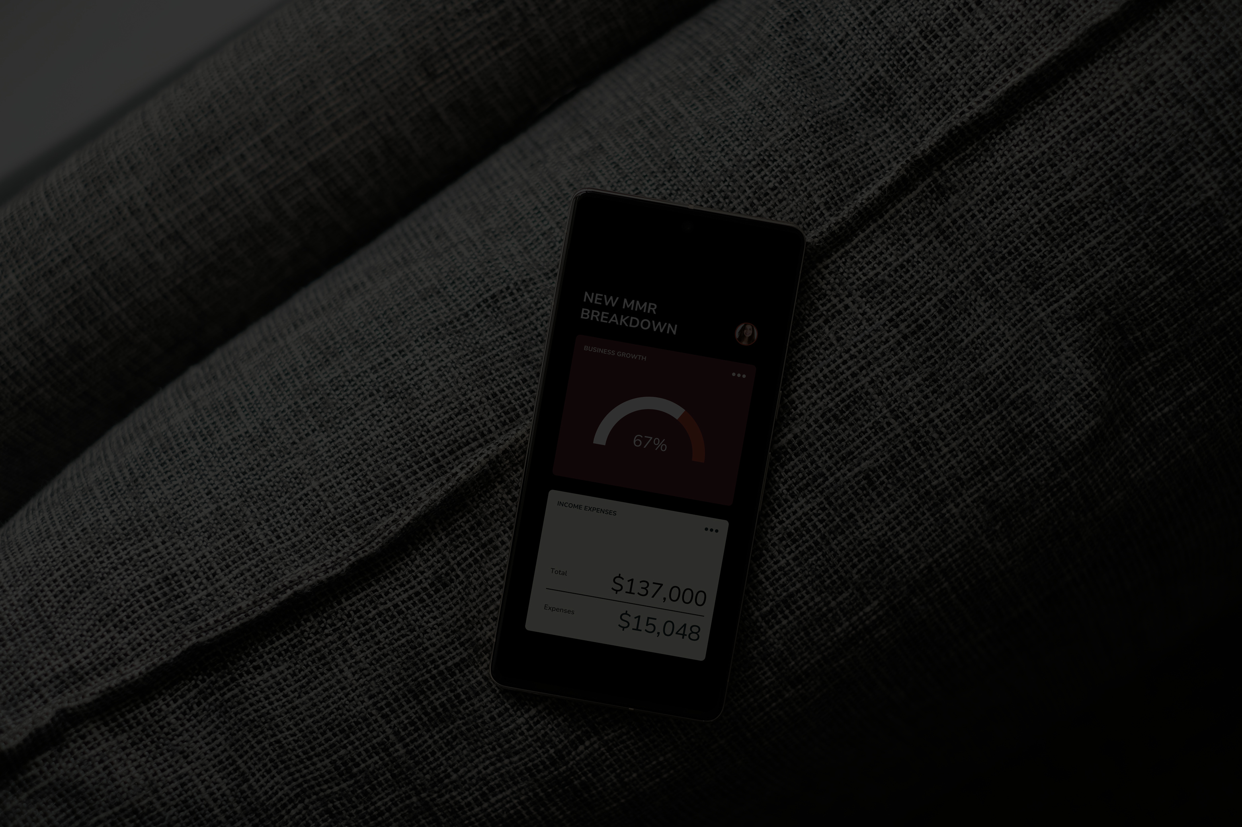
INTRODUCTION
IN THE TELECOM WORLD, KEEPING CUSTOMERS IS JUST AS IMPORTANT AS GAINING NEW ONES.
This project focuses on figuring out why customers are leaving (churning) and using that insight to help companies retain them better.
It’s all about turning data into smart decisions.

Slide 3

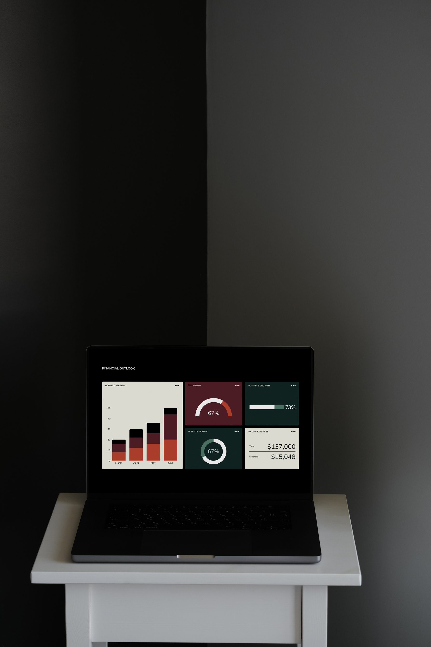
GOAL AND TOOLS
WHAT I WANTED TO DO:
PREDICT WHICH CUSTOMERS MIGHT LEAVE SOON
UNDERSTAND THE TOP REASONS BEHIND CHURN
SUGGEST WAYS COMPANIES CAN REDUCE CHURN
TOOLS I USED:
PYTHON (WITH LIBRARIES LIKE PANDAS, SEABORN, SCIKIT-LEARN)
SQL-STYLE QUERIES TO SUMMARIZE KEY PATTERNS
ELI5 FOR EXPLAINING THE MACHINE LEARNING MODEL

Slide 4

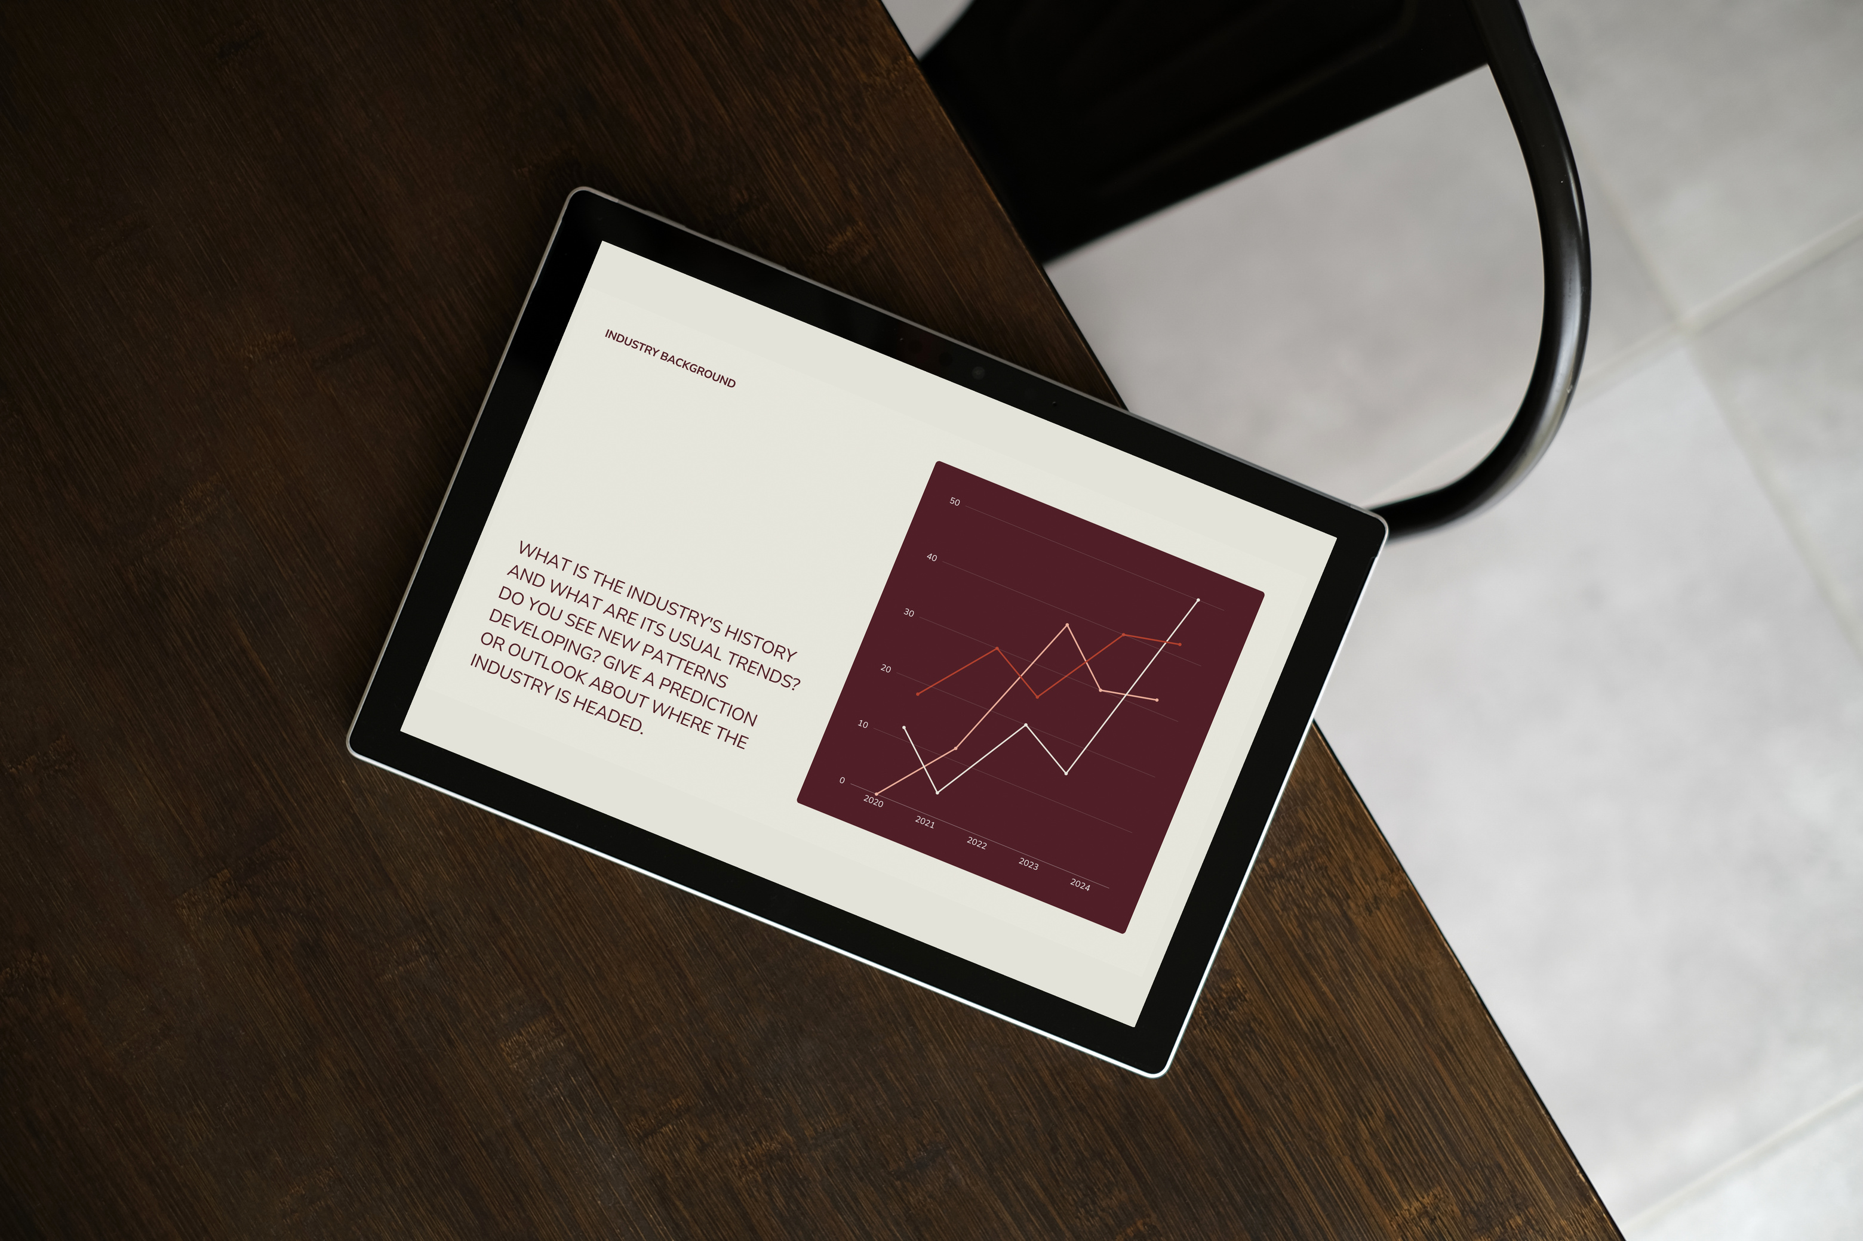
PREPARING THE DATA
CLEANED THE DATASET (ABOUT 7,044 CUSTOMER RECORDS)
REMOVED UNNECESSARY COLUMNS LIKE CUSTOMER IDS
FIXED MISSING VALUES
CONVERTED CATEGORIES INTO MACHINE-READABLE NUMBERS
SPLIT THE DATA INTO TRAINING (80%) AND TESTING (20%)

Slide 5
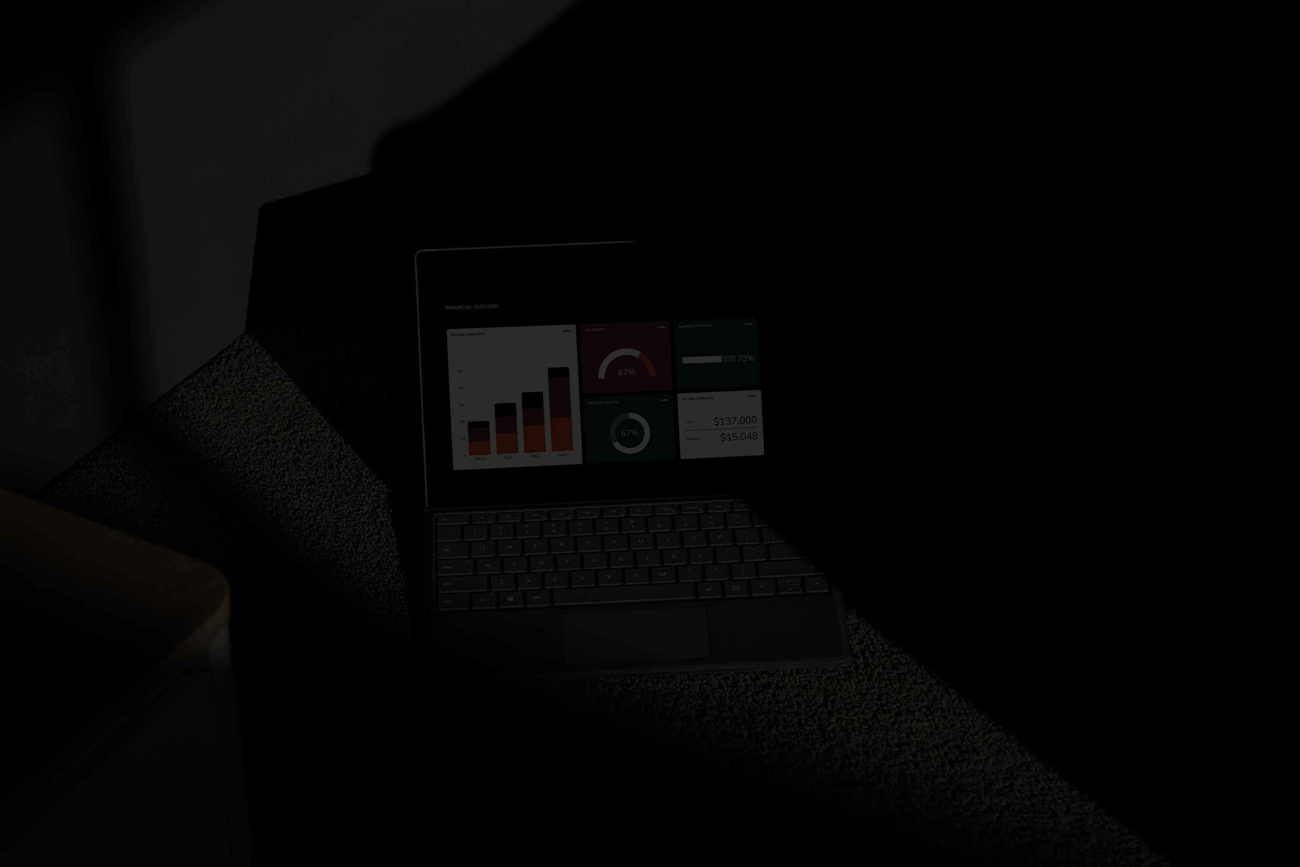
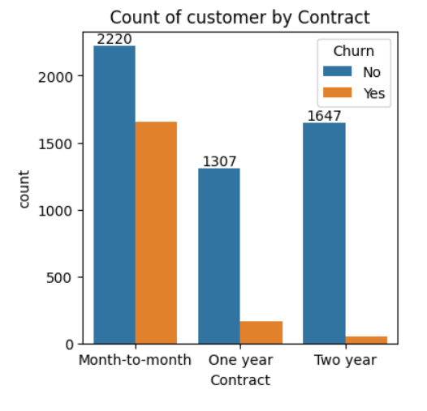
WHAT THE DATA SHOWS US
SHOWS CHURN IS HIGHEST IN MONTH-TO-MONTH CONTRACTS

Slide 6
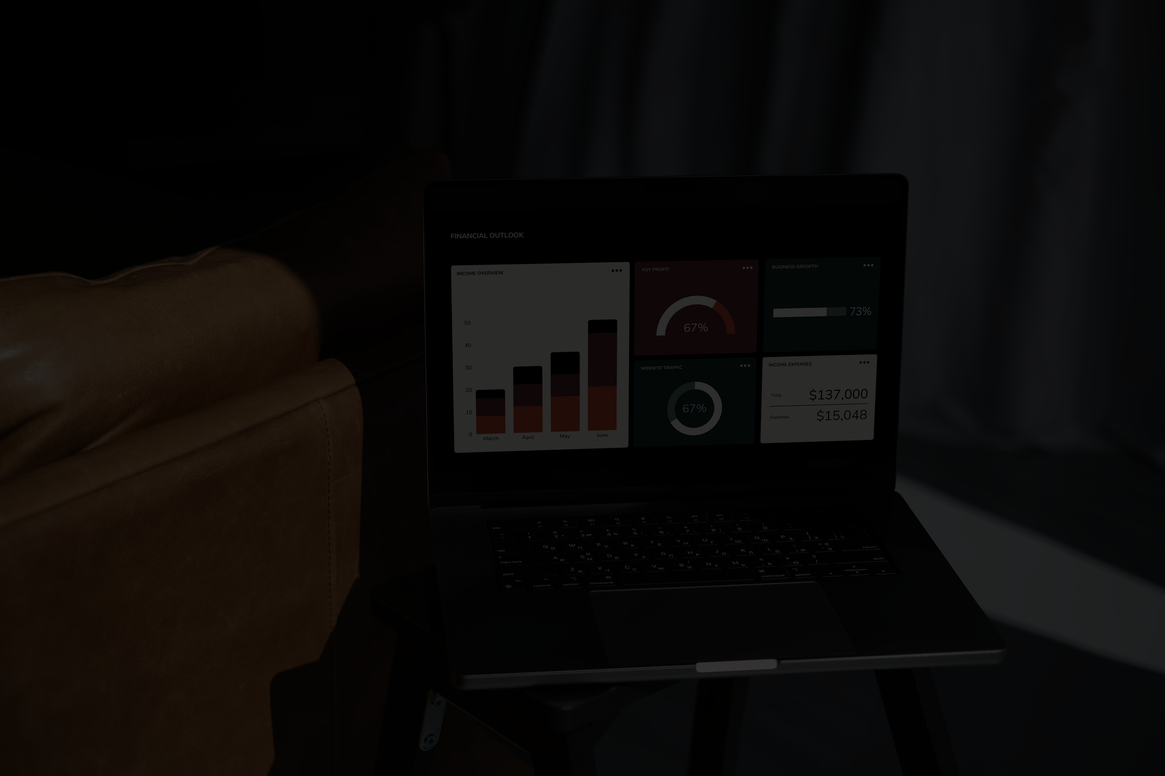
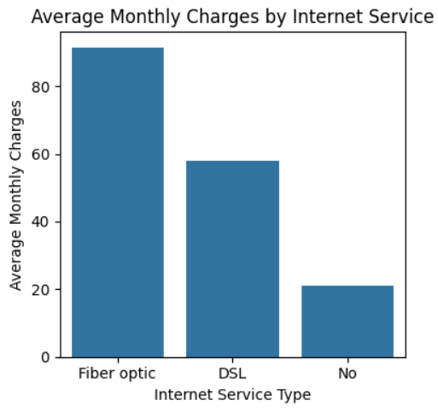
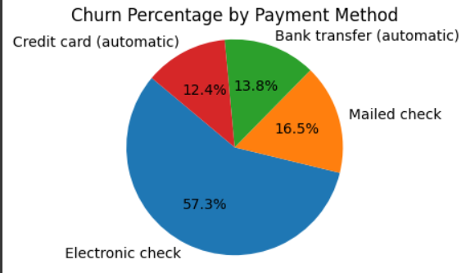
SQL INSIGHTS
ELECTRONIC CHECK USERS HAVE THE HIGHEST CHURN (45%).
FIBER OPTIC USERS PAY MORE AND CHURN MORE.

Slide 7
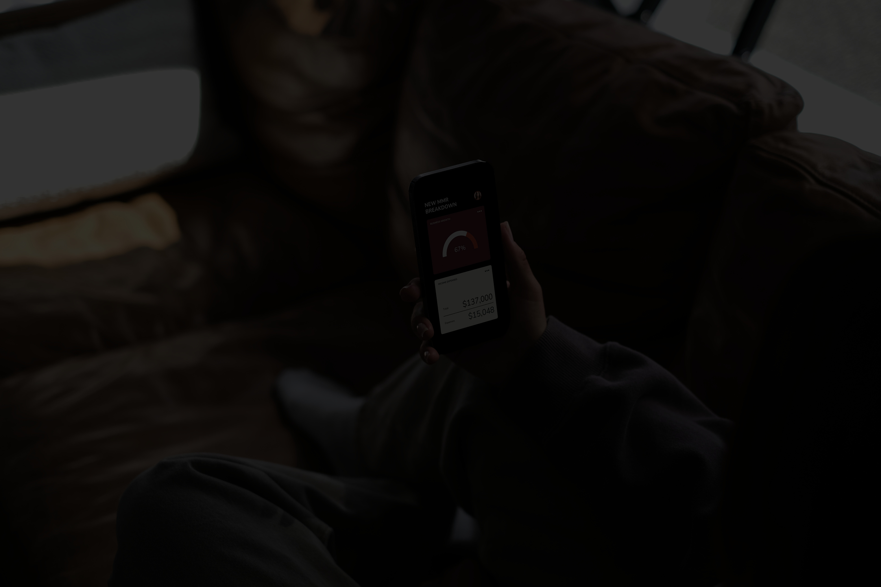
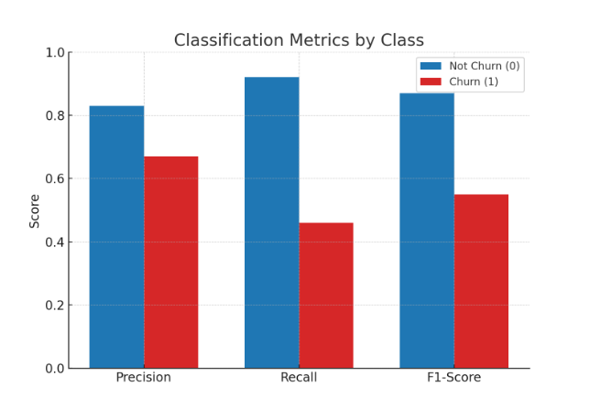
MODEL PERFORMANCE
THE MODEL ACHIEVED AN OVERALL ACCURACY OF ~80%, MEANING IT CORRECTLY PREDICTED CHURN IN 4 OUT OF 5 CASES.
IT PERFORMS BETTER AT PREDICTING NON-CHURNED CUSTOMERS (PRECISION: 83%, RECALL: 92%).
HOWEVER, FOR CHURNED CUSTOMERS, PERFORMANCE IS WEAKER (RECALL: 46%) — INDICATING SOME CHURN CASES ARE MISSED.
THERE'S ROOM FOR IMPROVEMENT IN CAPTURING TRUE CHURNS (USE BALANCING TECHNIQUES OR ADVANCED MODELS).

Slide 8
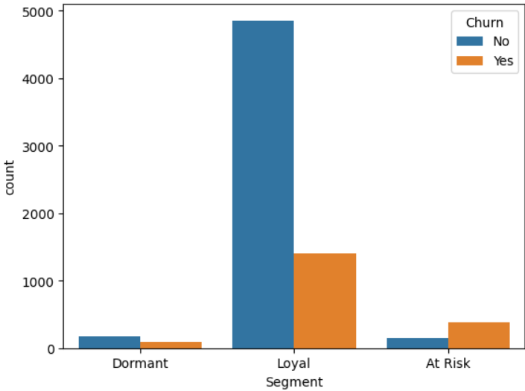
CUSTOMER SEGMENTATION
AT-RISK USERS NEED QUICK ACTION TO PREVENT CHURN.
DORMANT USERS CAN BE BROUGHT BACK WITH SPECIAL OFFERS OR MESSAGES.
LOYAL USERS SHOULD BE REWARDED TO KEEP THEIR TRUST STRONG.

Slide 9
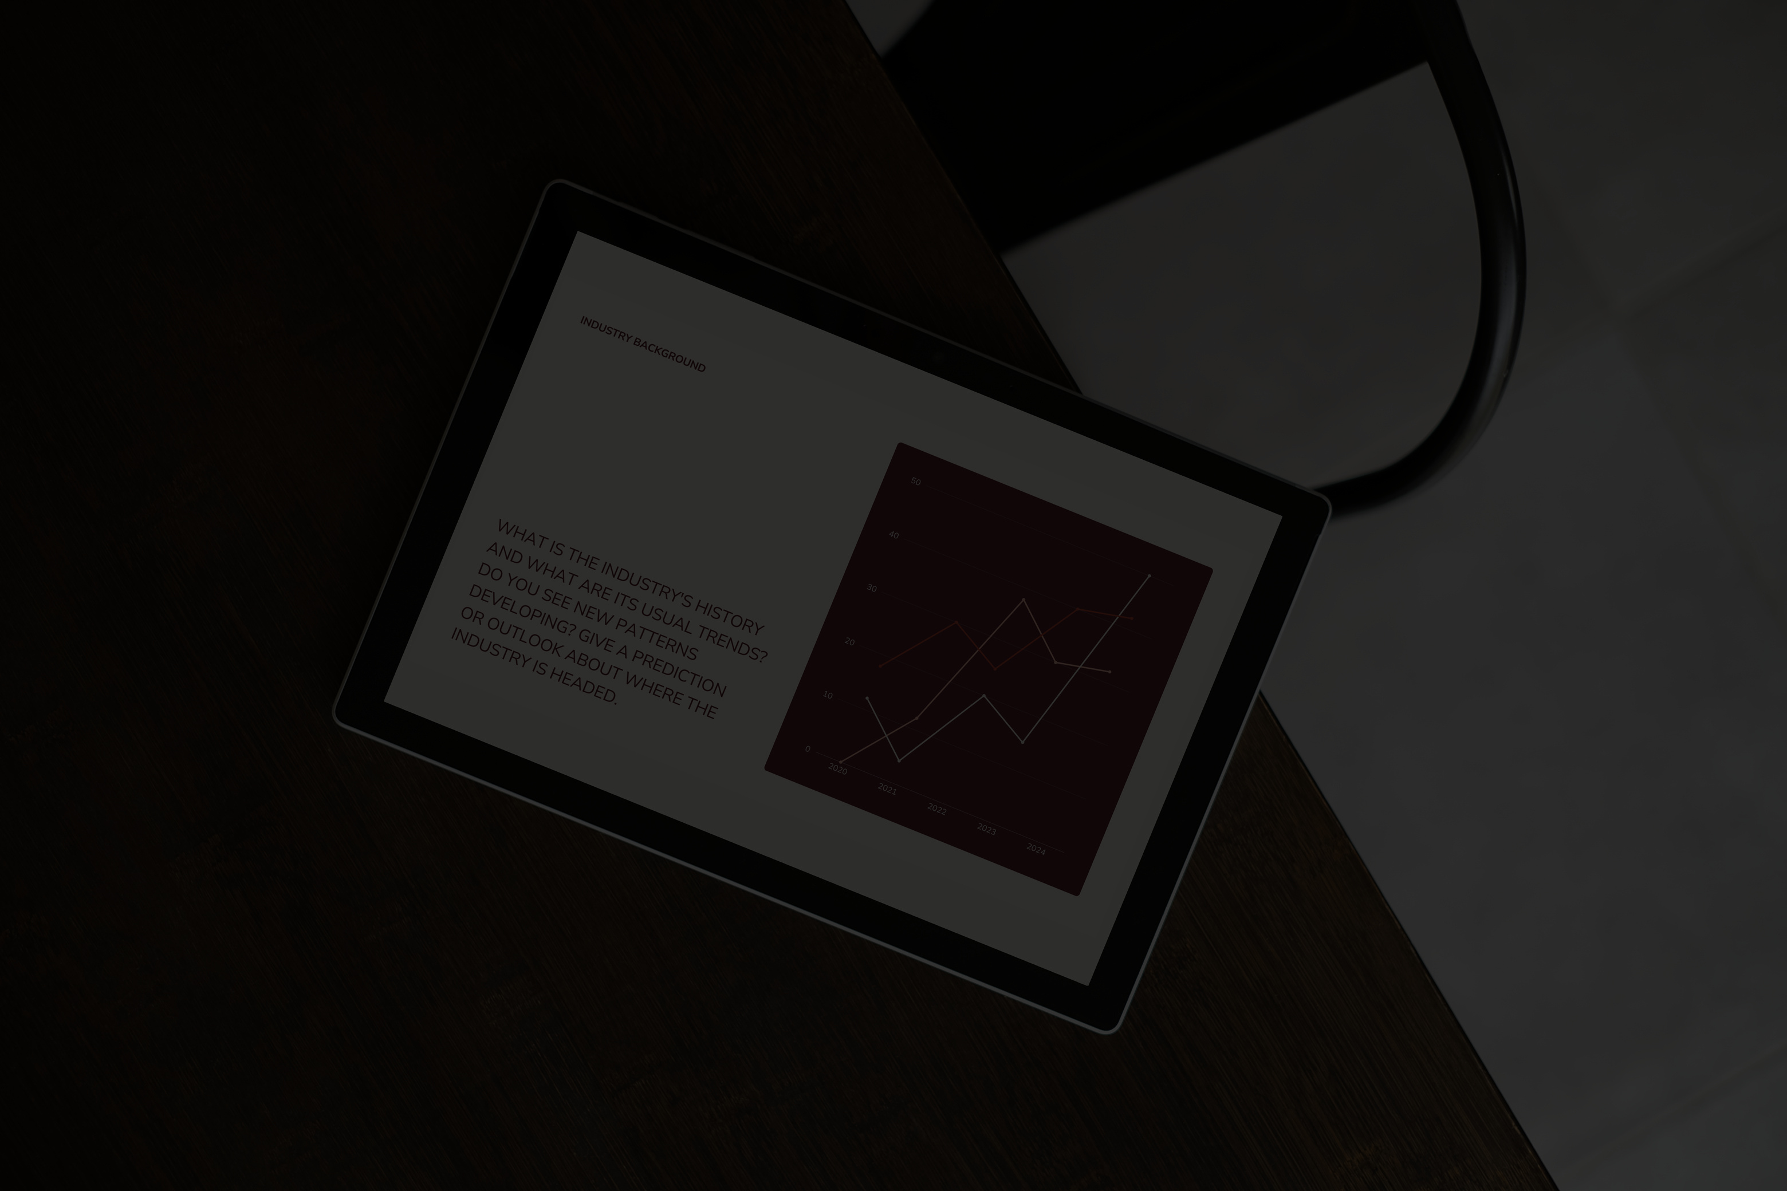
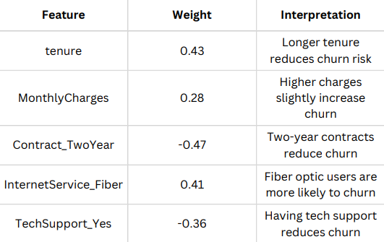
MODEL EXPLAINABILITY USING ELI5
ELI5 HELPS US UNDERSTAND WHICH FEATURES MOST INFLUENCE CUSTOMER CHURN DECISIONS. FEATURES WITH A
“POSITIVE WEIGHT INCREASE CHURN PROBABILITY”,
WHILE THOSE WITH
“A NEGATIVE WEIGHT HELP IN RETAINING CUSTOMERS ”.

Slide 10
FINAL RECOMMENDETIONS
FOCUS ON RETAINING MONTH-TO-MONTH AND NEW USERS (0–12 MONTHS) WITH ONBOARDING OFFERS AND LOYALTY PLANS.
ENCOURAGE USERS TO SHIFT FROM ELECTRONIC CHECK TO AUTO-PAYMENT METHODS FOR BETTER ENGAGEMENT.
MONITOR USERS WITH FIBER OPTIC + HIGH CHARGES AND OFFER SUPPORT OR BUNDLED DISCOUNTS.

Slide 11
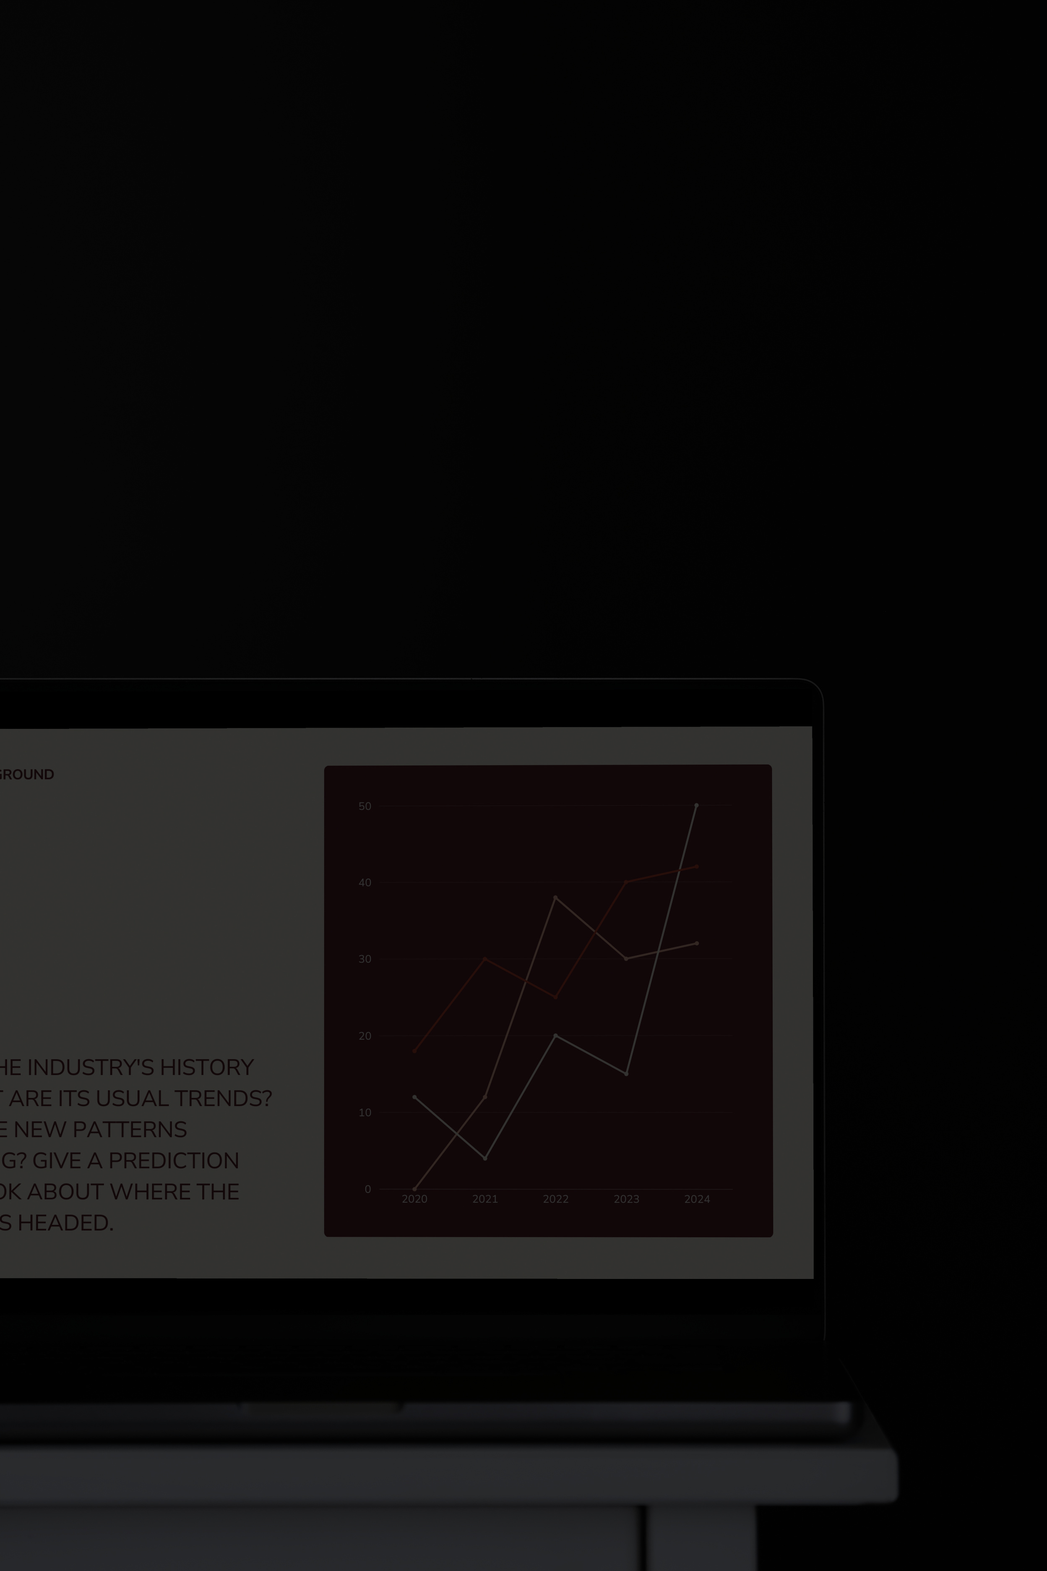
THANK YOU!

